Slide 1

Chapter 1
Introduction
Game Development 1
Denis McCarthy
E-mail: demccarthy@ait.ie
Room: U302

Slide 2
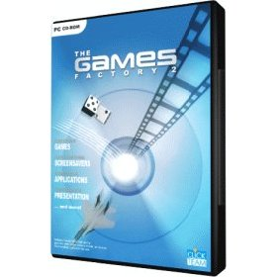
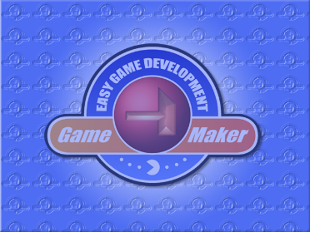
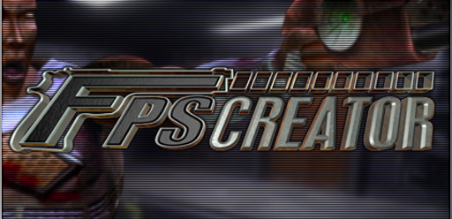
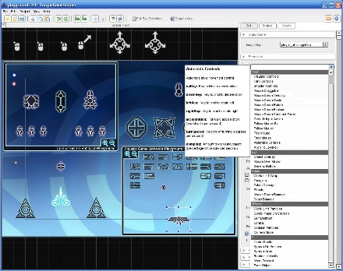
Game Engines
Many Game Engines available
  The Game Factory
  Torque
  Game Maker
  FPS (First person shooter)
  And many more…
All allow for rapid game development
Game Development 1
Denis McCarthy

Slide 3
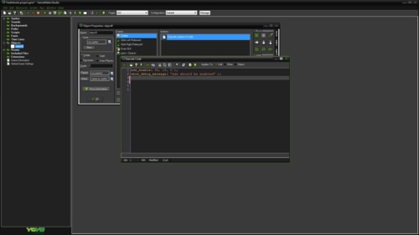
Why Game Maker?
Course not application specific
Want to teach game design
Game Maker has a good mixture of:
  Platform
  Maze
  Scrolling Shooters
  2D and 3D
  No programming required*
Game Development 1
Denis McCarthy

Slide 4
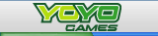
About Game Maker
Created by Dutch man, Mark Overmars
A free edition can be download from
  www.yoyogames.com
Current version is Game Maker Studio 1.4
Large online community at yoyo games
Lots of games available to play
Game Development 1
Denis McCarthy

Slide 5
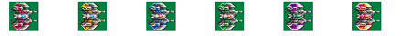
More about Game Maker
Games can be created very quickly
Drag and drop system
Uses object oriented design
  Events and actions assigned to game objects
To show power of Game Maker a game has been included in the lab section of moodle
  Return to sector 9
Game Development 1
Denis McCarthy

Slide 6

Getting started
Games created with Game Maker take place in one or more rooms.
Rooms are flat, not 3D, but they can contain 3D-looking graphics.
Rooms have a background.
In these rooms you place objects, which you can define in the program:
  Walls
  Balls
  Characters
  Monsters
Game Development 1
Denis McCarthy

Slide 7

Getting started (contd…)
Some objects, like walls, just sit there and don’t do anything.
Other objects will move around and react to input from the player and to each other.
Objects need some image to make them visible on the screen. (Called sprites)
Certain things will happen to objects. Such happenings are called events.
Objects can take certain actions when events happen.
You can also define sounds to play a sound effect.
Game Development 1
Denis McCarthy

Slide 8
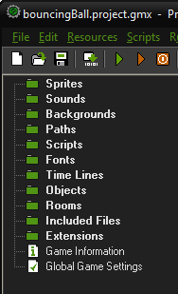
Game Maker Summary
So in summary, the following things (often called resources) play a crucial role:
  objects: which are the true entities in the game
  rooms: the places (levels) in which the objects live
  sprites: (animated) images that are used to represent the objects
  sounds: these can be used in games, either as background music or as effects
  backgrounds: the images used as background for the rooms
There are more resources in Game Maker, but these are for more advanced features which we will look at later.
Game Development 1
Denis McCarthy

